Slide 1
DHCP
Dynamic Host Configuration Protocol

Slide 2
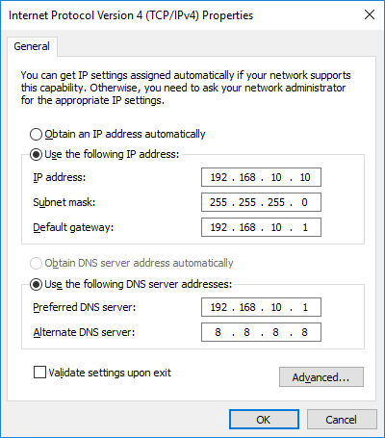
Static IP Assignment
It is possible to allocate IP addresses statically
We must avoid duplication /conflict
Administrators need to be involved in allocating addresses (some people do this with a spreadsheet)
Easy for mistakes, time-consuming and harder to manage re-allocation

Slide 3
DHCP
DHCP was developed in 1993 as an improvement of the BOOTP protocol
RFC 2131 - Dynamic Host Configuration Protocol
BOOTP allowed the initial device configuration to be applied over a network (bootstrapping)
IP address
File to load (OS)
You will still see reference to the BOOTP protocol when looking through network data captures

Slide 4
Subnet
A DHCP server may be configured with one or more subnets, which will provide a range of IP addresses and configuration options are to be issued
An example of a subnet within the dhcpd.conf file is as follows …
subnet 192.168.0.0 netmask 255.255.255.0
{ range 192.168.0.100 192.168.0.199; }

Slide 5
Lease Duration
The administrator may select the duration of any lease configured by DHCP
In the isc-dhcp-server, the following directives can be used:
max-lease-time
default-lease-time
default-lease-time 21600;
max-lease-time 43200;

Slide 6
IP address lease
DHCP Enabled. . . . . : Yes
IPv4 Address. . . . . : 10.100.100.122(Preferred)
Subnet Mask . . . . . : 255.255.255.0
Lease Obtained. . . . : Sunday, 1 March 2020 5:13:38 p.m.
Lease Expires . . . . : Sunday, 12 March 2020 5:13:38 p.m.
Default Gateway . . . : 10.100.100.1
DHCP Server . . . . . : 10.100.1.3
The client leases an IP address for a defined timeframe, (typically 24 hours, to week or more)
While the client is connected it will try to renew the IP address
You do not want to run out of addresses !!
Lets work out some lease duration examples

Slide 7
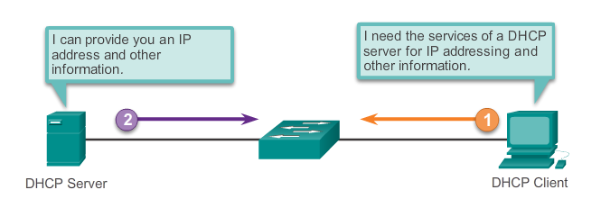
What is DHCP
DHCP means Dynamic Host Configuration Protocol
Used to assign an IP address to device dynamically
Service provided by a Server
Details of DHCP can be found under RFC2131

Slide 8
Commonly applied DHCP options
IP Address (Dynamically Given)
Subnet Mask (Static)
Default Gateway (Static)
Primary DNS address (Static)
Secondary DNS address (Static)
Scope – Total range of IP address given out
Lease – Time the IP address leased to host
Reservations – Static IP address given to certain devices

Slide 9
How DHCP works
DHCP works in a four step process using UDP
DHCPDISCOVER
DHCPOFFER
DHCPREQUEST
DHCPARK
The Client uses port 68
The Sever using port 67

Slide 10
DHCPDISCOVER
Client
Server
192.168.0.254
First frame the client sends to a DHCP Server is a the DHCP Discover Packet
“Can someone give me an address”
It uses 255.255.255.255 as the destination and a source address as 0.0.0.0
Question: why is it a broadcast and why is there no source address?

Slide 11
DHCPOFFER
Client
Server
192.168.0.254 /24
The DHCP server will respond to the client with a DHCPOFFER packet.
“I can offer you 192.168.0.3 with a lease time of 3600 seconds”
It uses 255.255.255.255* as the destination and a source address as 192.168.0.254
Notes:
Note, some systems will use a unicast response

Slide 12
DHCPREQUEST
Client
Server
192.168.0.254
The DHCP client respond s back with a DHCPREQUEST
“I accept the offer that will allow me to use 192.168.0.3 for a lease time of 3600 seconds ”
It still uses 255.255.255.255 as the destination and a source address as 0.0.0.0

Slide 13
DHCPARK
Server
Client
192.168.0.254 /24
The DHCP server responds back to the DHCPREQUEST
“As of now you can use 192.168.0.3 for 3600 seconds“
It uses 255.255.255.255* as the destination and a source address as 192.168.0.254
Notes:
Note, some systems will use a unicast response

Slide 14
When to statically assign details
Network infrastructure
Devices that provide services
Servers
Printers

Slide 15
Packet Tracer Demonstration

Slide 16
Lab
In the lab this week we will getting your server and clients installed and operational
Next week we will start to configure your DHCP server

